Slide 1
Cloud Computing and Modern Applications
December 2022
Notes:
Hello. Thank you for joing us today.
For those who don't know me. My name is Fares Ghanimah. I lead the Central Technology group here at William Blair.

Slide 2
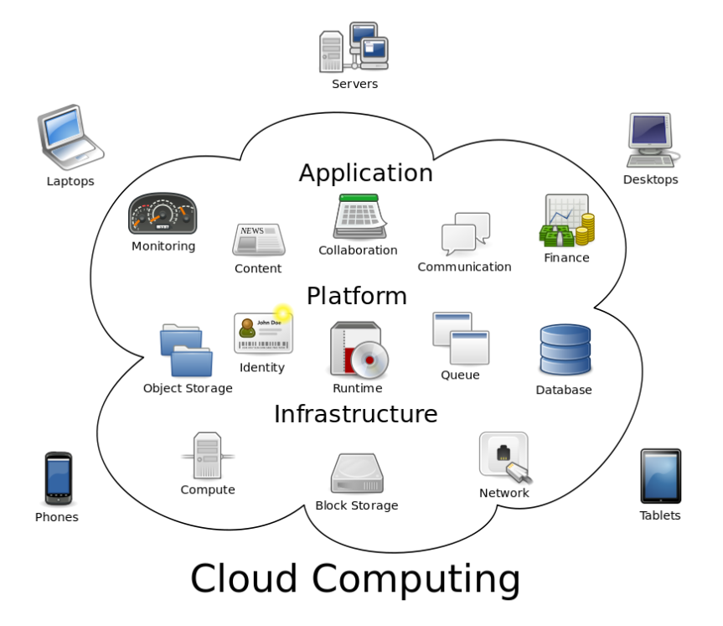
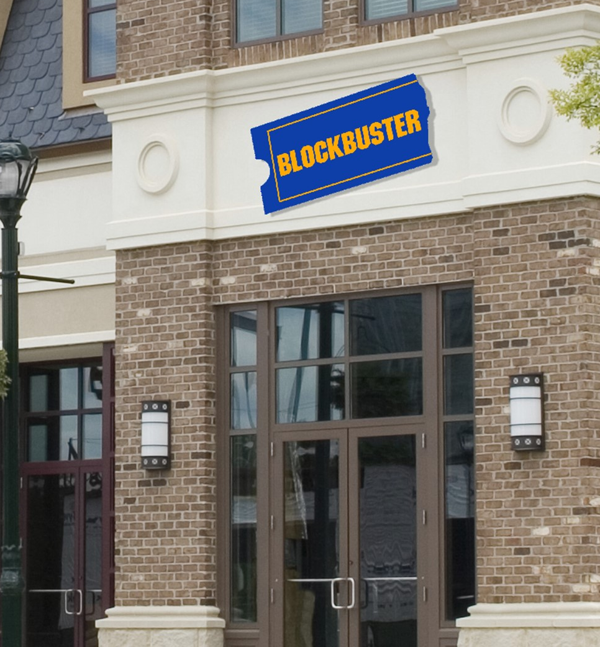




Every company today is a data driven company
Cloud Computing and Modern Applications

Slide 3
Goals / Audience
Agenda / Objective
9:30: Arrival
9:45 – 10 am: Basic cloud computing overview
Getting Logged In
What is the cloud?
If you know one cloud, you know them all!
Quantum Computing
10 – 10:15 am: Natural Language Processing demo
10:15 – 12 pm: Video game model training exercise
12 pm – 12:45 pm: Lunch
12:45 – 1 pm: Closing
- Review trained models
1 pm: Dismissal

Slide 4
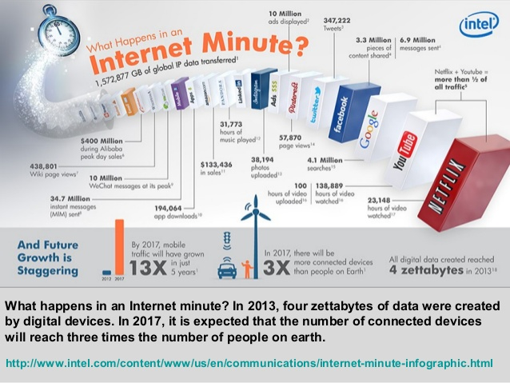
The Cloud is driving our tech world today

Slide 5
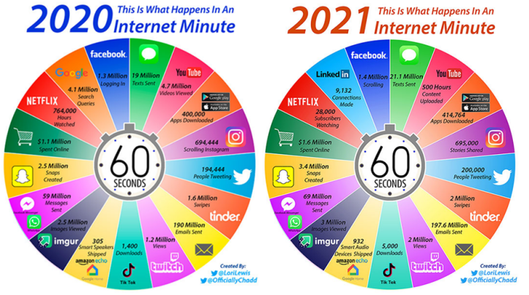
The Cloud is driving our tech world today

Slide 6
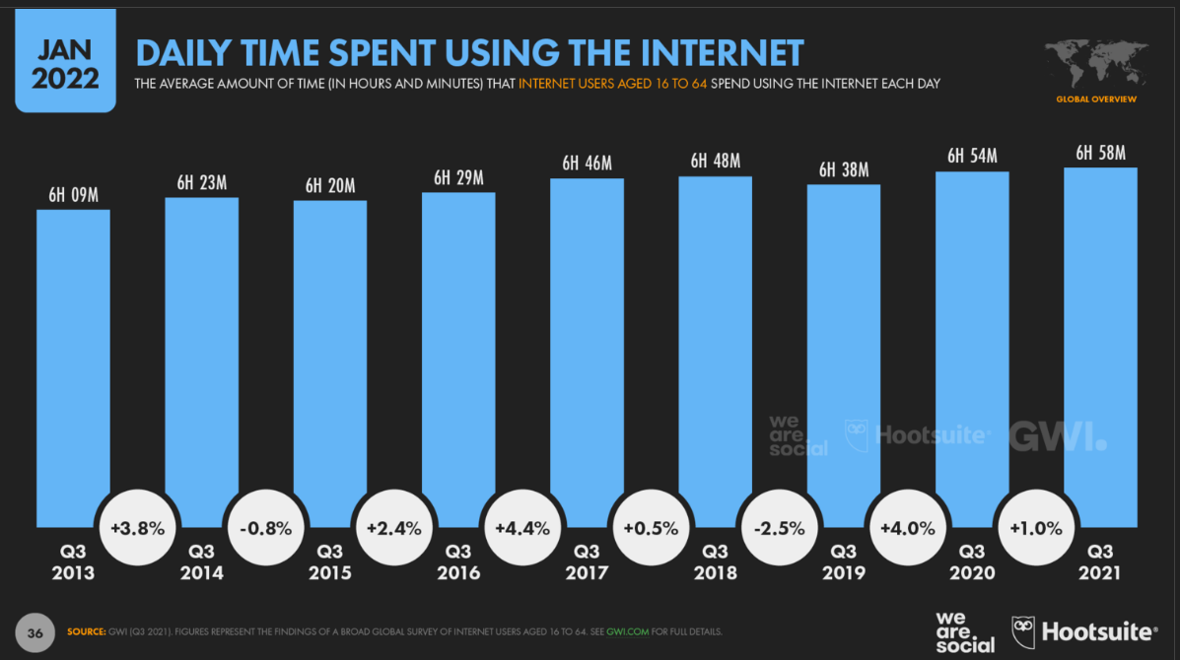
The Cloud is driving our tech world today

Slide 7
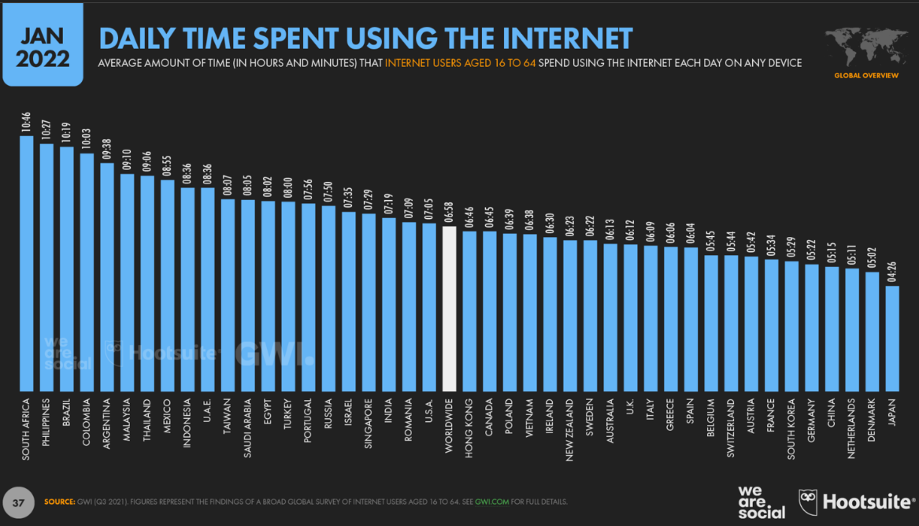
The Cloud is driving our tech world today

Slide 8
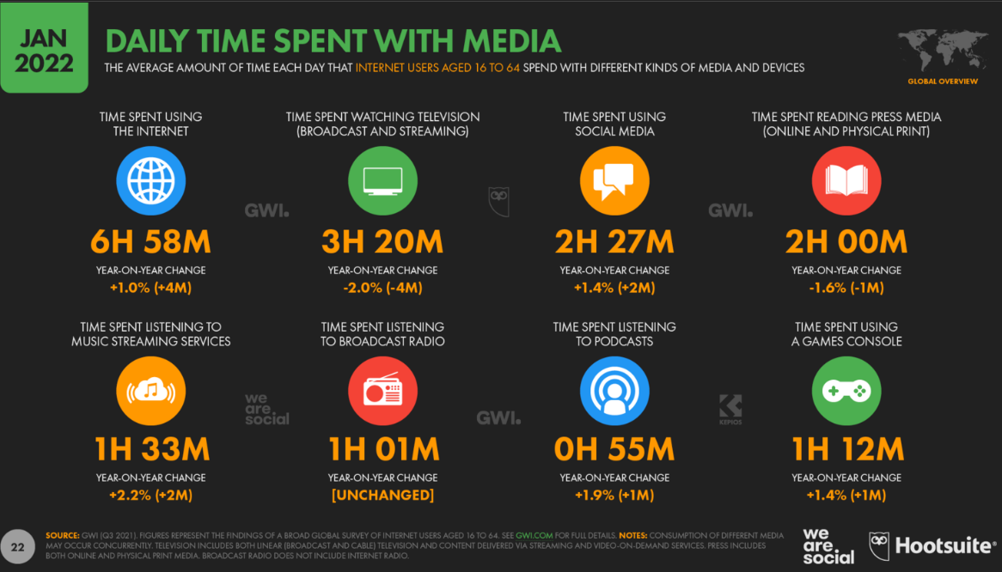
The Cloud is driving our tech world today

Slide 9
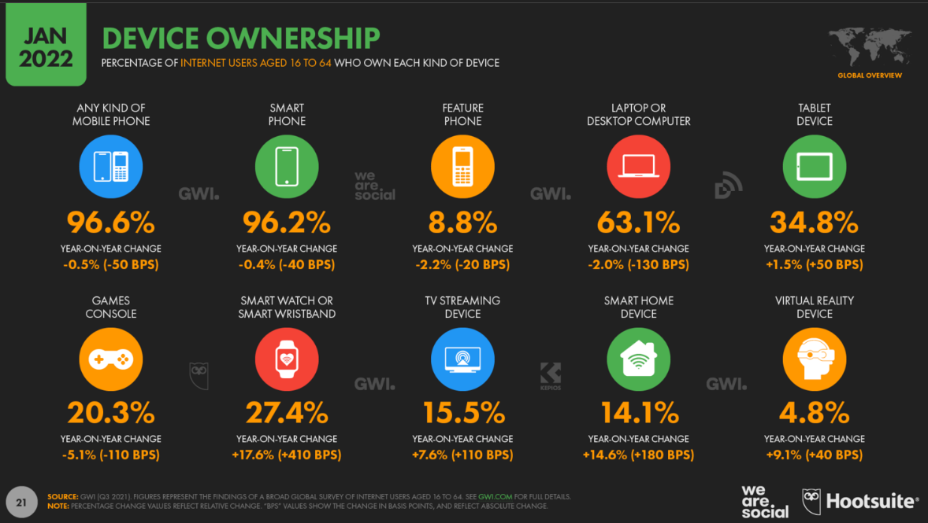
The Cloud is driving our tech world today

Slide 10
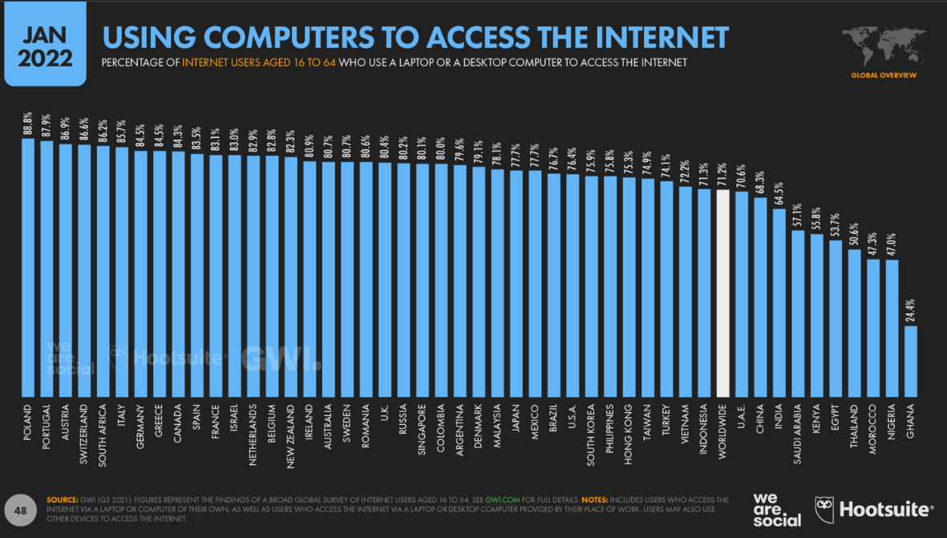
The Cloud is driving our tech world today

Slide 11
What is the Cloud
Notes:
Let's get started.

Slide 12
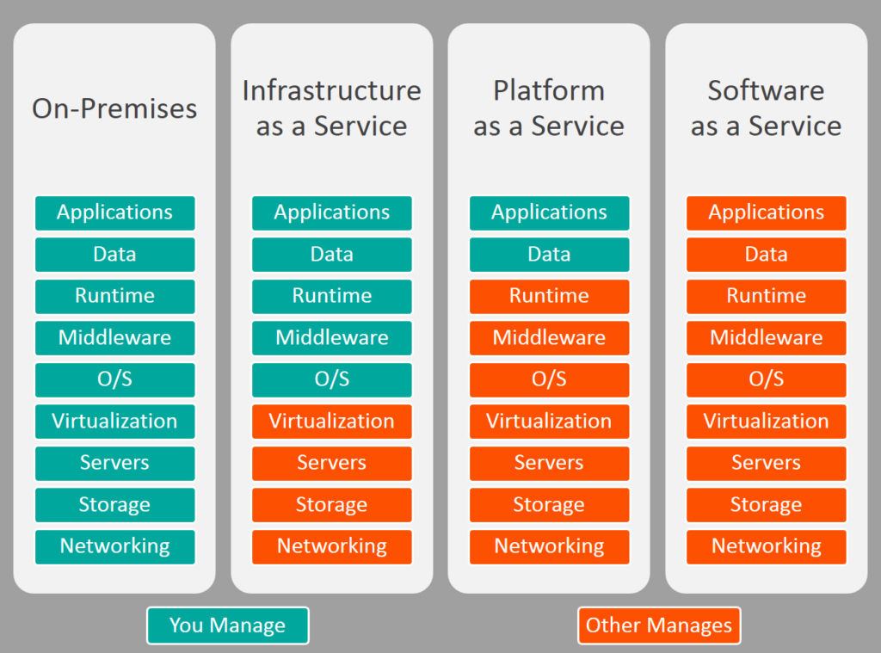
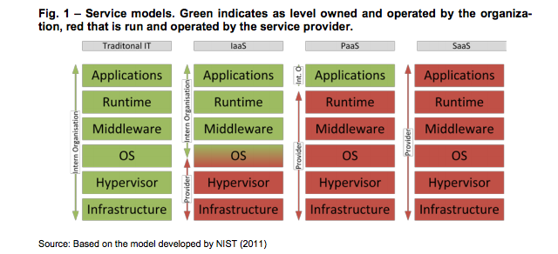
What is the cloud?
Green indicates the levels owned and operated by William Blair
Red levels are run and operated by our service providers

Slide 13
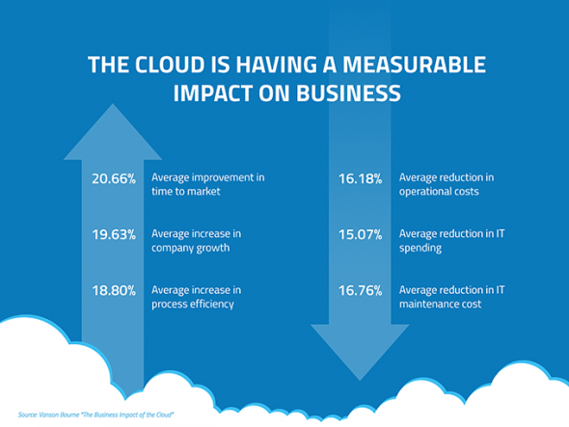
Why cloud Computing?
Competitive Advantage
Efficiency / cost reduction
Data security
Scalability
Mobility
Disaster recovery
Control over your data
https://www.globaldots.com/cloud-computing-benefits/

Slide 14
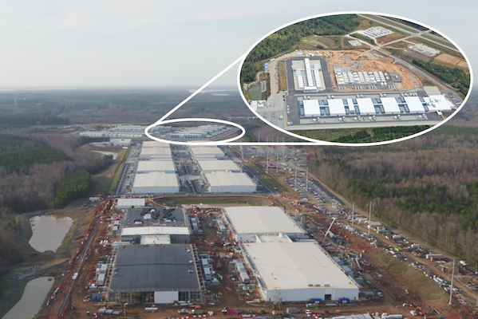
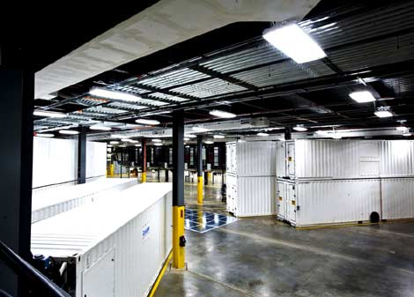
What is the cloud?

Slide 15

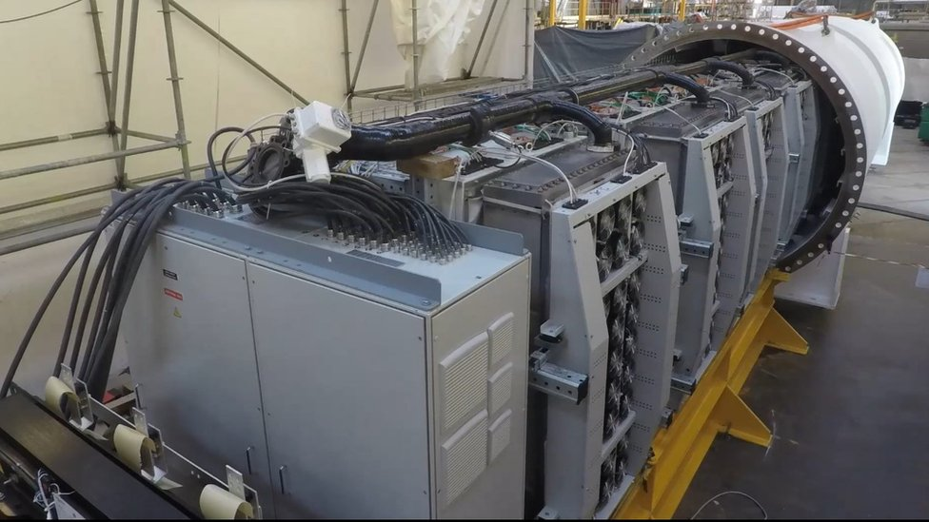
What is the cloud?

Slide 16
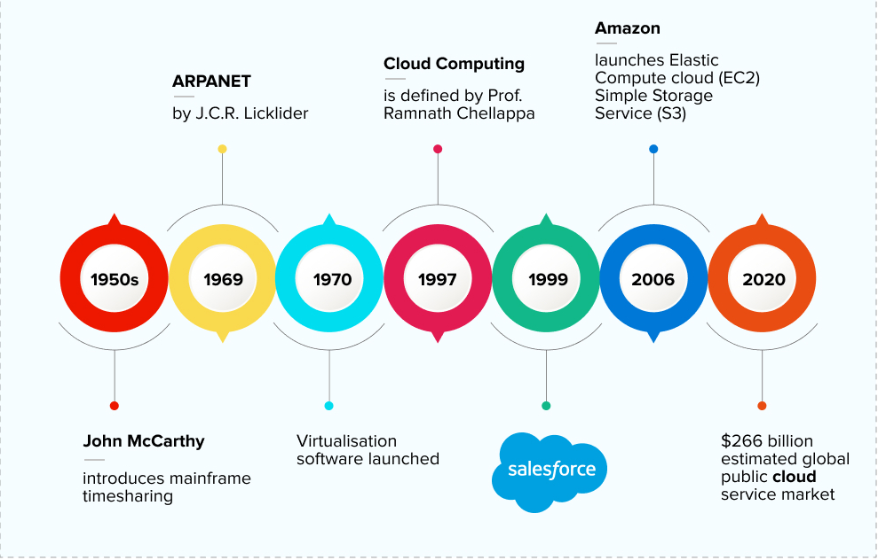
History of Cloud Computing

Slide 17
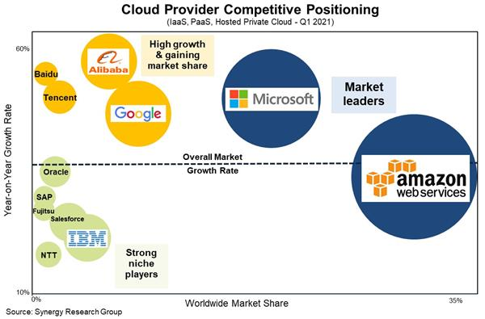
Who’s who in Cloud today

Slide 18
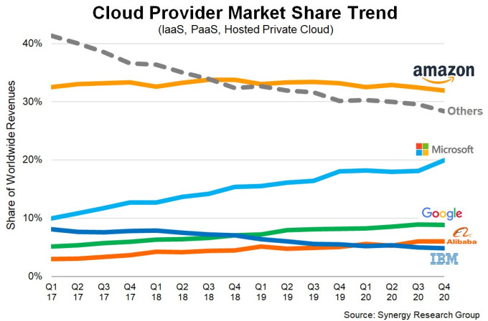
Cloud Provider Market Share Over Time

Slide 19
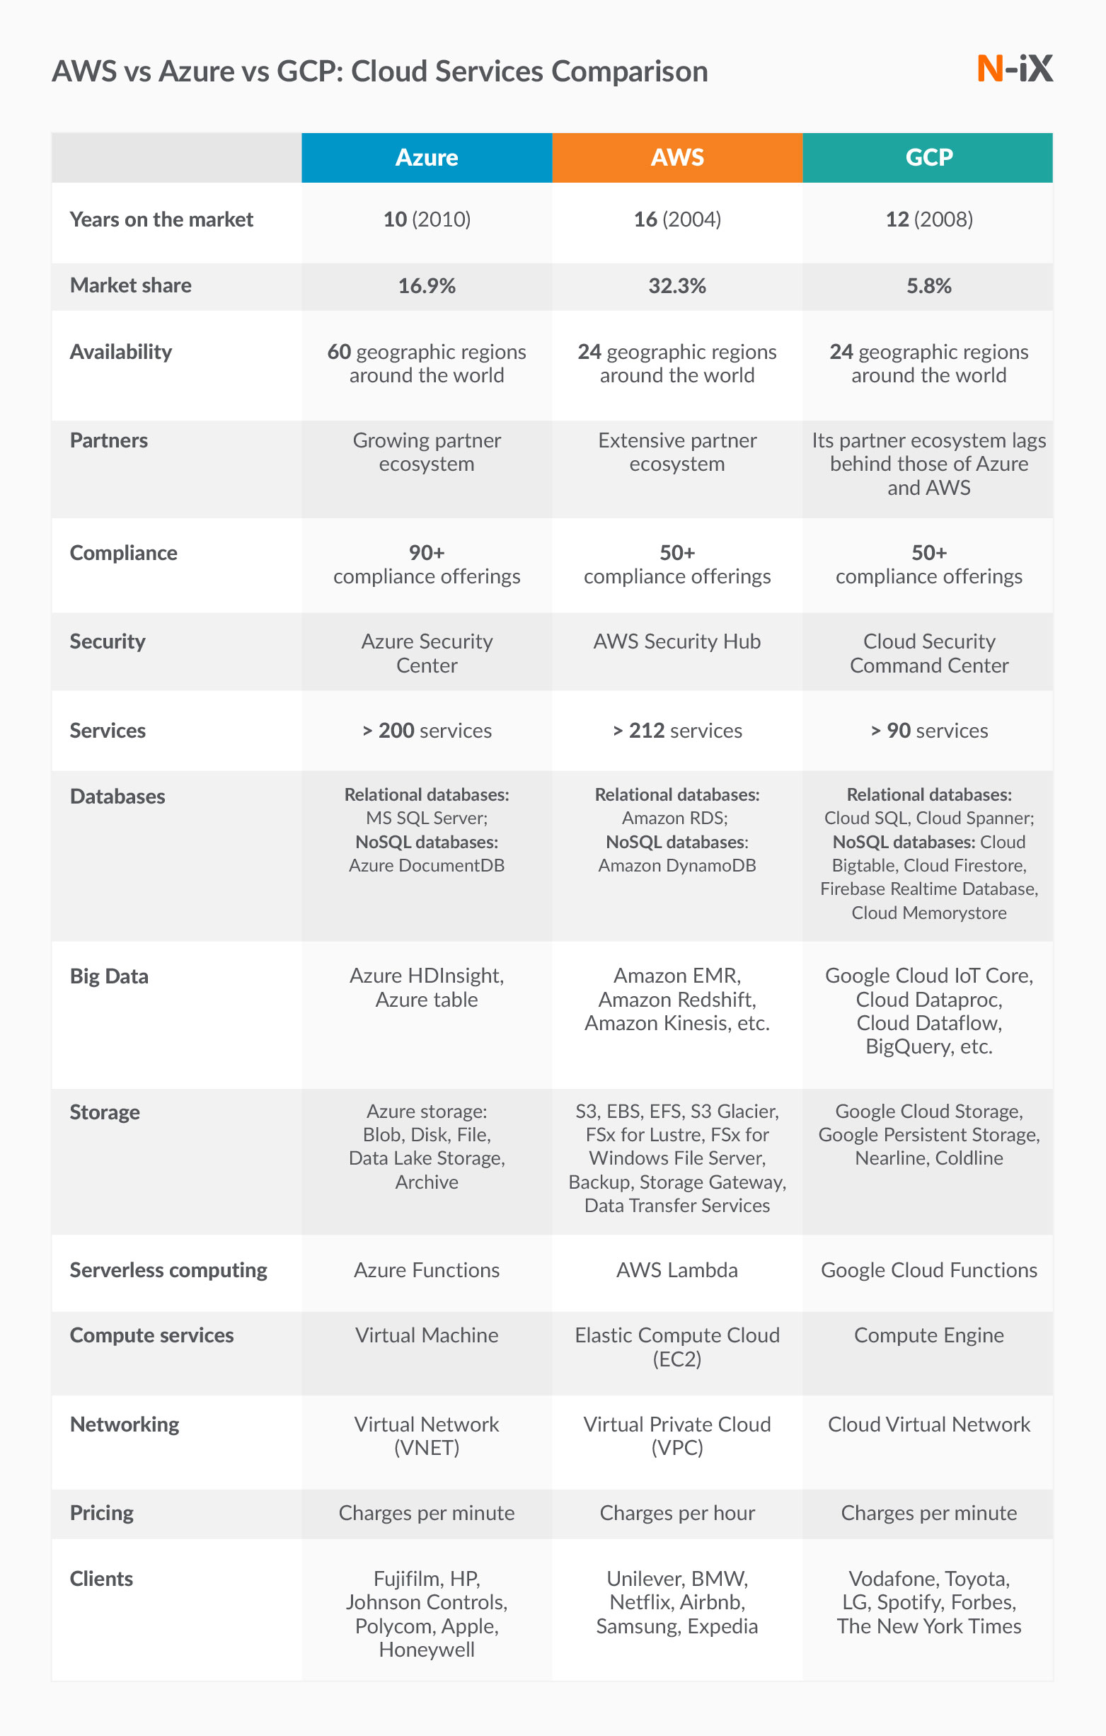
Cloud Provider Market Share Over Time

Slide 20
Cloud Provider Market Share Over Time

Slide 21
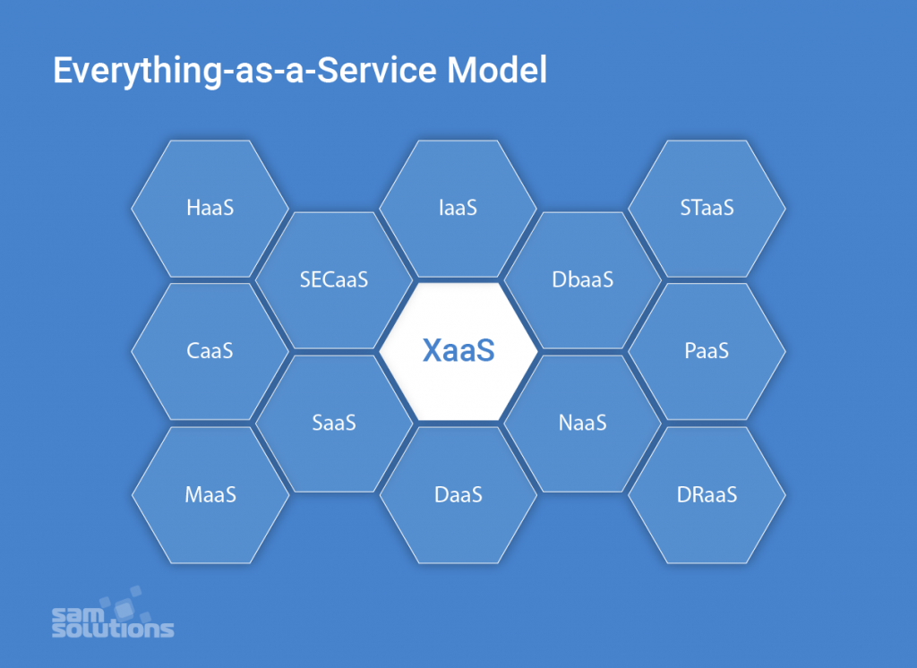
In Cloud Computing – Everything is an “aaS” (as a Service)

Slide 22




SaaS - Software as a Service
License and away we go!!
Social Media Sites
G Suite
Canvas and PowerSchool
Financial Sites

Slide 23


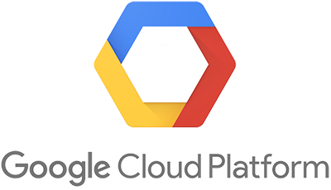
Let’s look closer at: IaaS – Infrastructure as a Service & PaaS – Platform as a Service

Slide 24

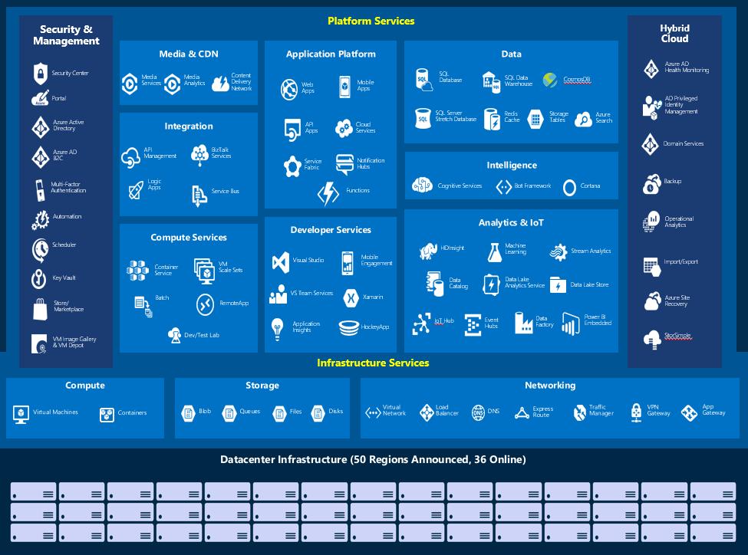
Microsoft Azure IaaS & PaaS

Slide 25

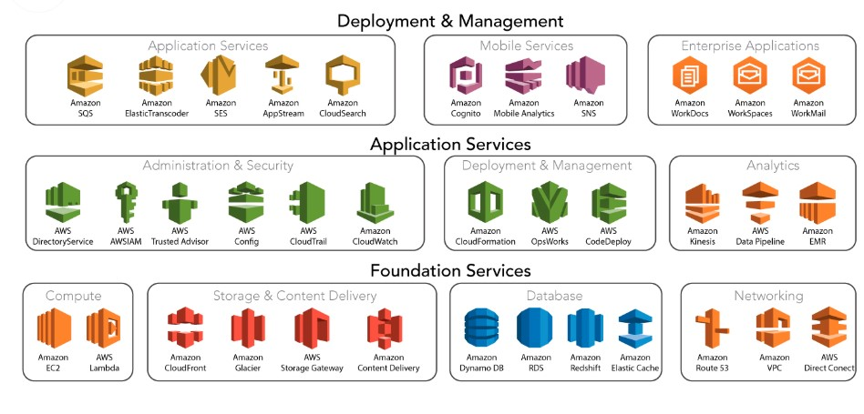
AWS IaaS & PaaS

Slide 26

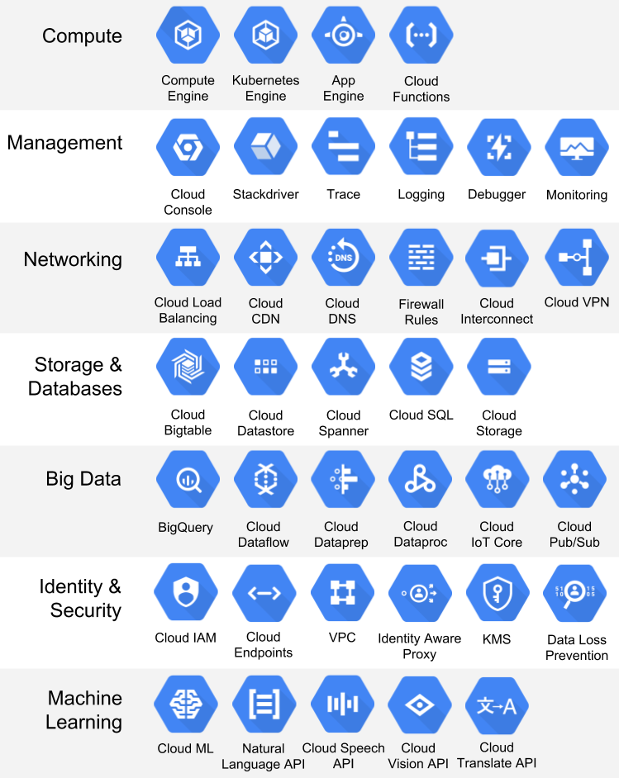
GCP IaaS & PaaS

Slide 27
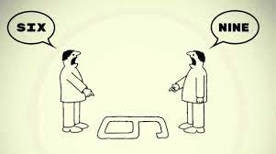
If you know one Cloud… You know them all

Slide 28
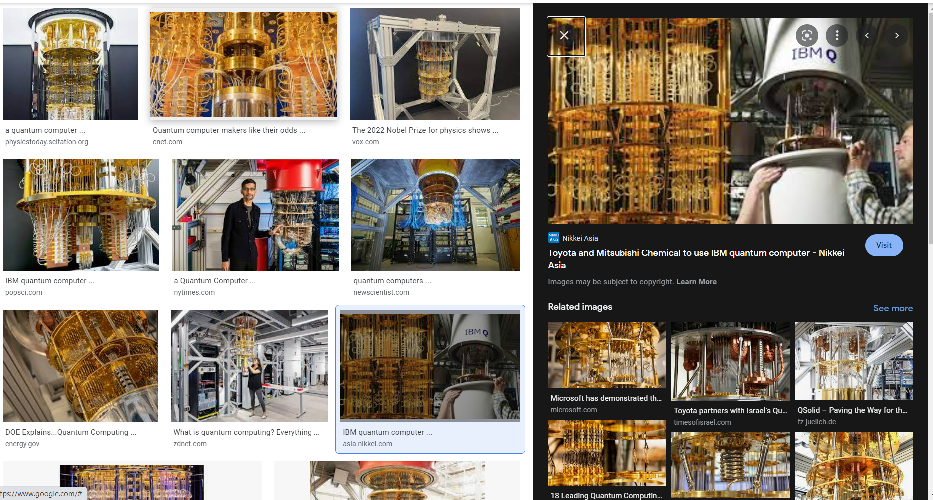
Quantum Computing
Some quantum inspiration: Why quantum computing? https://youtu.be/6WaYfPAkFtQ Getting more specific… (5 years ago and I love this person. She is my favorite) https://youtu.be/S52rxZG-zi0 Where is quantum today and the roadmap at IBM https://m.youtube.com/watch?v=ky32162U06M&list=PL0VD16H1q5IMoxY063Peci3GzWk6x4e0f&index=1&t=437s Ally Bank - a year ago talking about what they wanted to start doing… https://youtu.be/_u8w7lH0LJ0 Ally solutions in Azure quantum today: https://customers.microsoft.com/en-US/story/1516457336660340395-ally-financial-banking-capital-markets-azure-quantum Get Started in Azure: https://azure.microsoft.com/en-us/services/quantum/#overview
A year ago - What is quantum computing? Everything you need to know about the strange world of quantum computers | ZDNet:
https://www.zdnet.com/google-amp/article/what-is-quantum-computing-everything-you-need-to-know-about-the-strange-world-of-quantum-computers/
Microsoft has demonstrated the underlying physics required to create a new kind of qubit
https://twitter.com/markrussinovich/status/1503482652074004481
https://news.microsoft.com/innovation-stories/azure-quantum-majorana-topological-qubit/
Notes:
This is our complete portfolio of training and certification for Azure,
These are the certifications we have released to meet market needs.
All our certifications prove that a person has the skills to help organizations maximize the capabilities of the cloud to achieve desired business outcomes.
We update our certifications regularly to reflect the change of pace of business and technology. Our certifications remain technically accurate and relevant, with updates occurring every two months, and additional roles and specialties added as the market requires.
So, how do you leverage all the resources available and set your team on a learning journey?
designed to meet industry and market needs, with roles, skills and capabilities needed for the job, including specializations, hands-on experience and practice requirements.

Slide 29

Cloud Computing and Modern Applications

